Slide 1
PASSWORD STRENGTH
Presented By:
Sandhiya T - Salem college of engineering and technology -CSE

Slide 2
Outline
Problem Statement (Should not include solution)
Proposed System/Solution
System Development Approach (Technology Used)
Algorithm & Deployment
Result (Output Image)
Conclusion
Future Scope
References

Slide 3
Problem Statement
Design a system that evaluates the strength of user passwords by assessing their complexity, including factors such as length, character variety, and avoidance of common patterns or dictionary words, in order to enhance overall security and reduce the risk of unauthorized access."

Slide 4
Solution
"implementationa password strength checker that analyzes the length, complexity, and uniqueness of user-generated passwords, providing feedback and suggestions to users to create stronger passwords. Utilize techniques such as enforcing minimum length requirements, requiring a mix of alphanumeric and special characters, and checking against commonly used passwords or dictionary words to enhance overall security measures.“

Slide 5
System Development Approach
Minimum Length: Requiring passwords to be a certain number of characters long, often between 8 to 12 characters.
Complexity: Mandating the use of a combination of different character types, such as uppercase letters, lowercase letters, numbers, and special characters.
Exclusion of Common Words: Prohibiting the use of easily guessable passwords, such as "password," "123456," or common dictionary words.
Expiration and Renewal: Setting rules for password expiration and requiring users to change their passwords periodically.
Account Lockout Policies: Implementing measures to lock user accounts after multiple failed login attempts, preventing brute force attacks.
Two-Factor Authentication (2FA): Offering an additional layer of security beyond passwords, such as a verification code sent to a mobile device or email.

Slide 6
Algorithm & Deployment:
There isn't a single algorithm universally agreed upon for determining password strength, but several common approaches exist. Here's a simplified version of an algorithm that many systems use to assess password strength:
1. *Length Check*: Ensure the password meets a minimum length requirement, typically around 8 characters or more.
2. *Complexity Check*: Evaluate if the password includes a combination of character types, such as uppercase letters, lowercase letters, numbers, and special characters.
3. *Common Patterns Check*: Look for common patterns or easily guessable sequences (e.g., "123456" or "password").
4. *Dictionary Check*: Check if the password is a common word or easily guessable based on a dictionary attack.

Slide 7
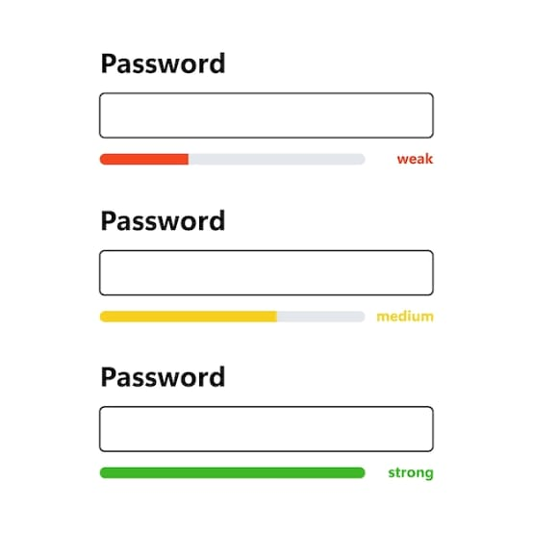
Result (Output Image)

Slide 8
Conclusion
In summary, password strength is paramount for safeguarding sensitive data and accounts from unauthorized access. A robust password should be sufficiently long and complex, incorporating a diverse combination of uppercase and lowercase letters, numbers, and special characters. By emphasizing the importance of strong passwords, implementing password strength-checking tools, and promoting best practices such as regular password updates and multi-factor authentication, organizations and users can significantly enhance security measures, mitigating the risk of data breaches and unauthorized access.

Slide 9
Future Scope
The future scope for password strength lies in the advancement of authentication technologies and the adoption of more secure authentication methods beyond traditional passwords. This includes the development and implementation of biometric authentication such as fingerprint recognition, facial recognition, and iris scanning, which offer enhanced security and convenience for users. Additionally, advancements in machine learning and artificial intelligence can be leveraged to analyze user behavior patterns and dynamically adjust authentication requirements based on risk assessment

Slide 10
Reference
For references on password strength, you can refer to well-established guidelines from organizations such as the National Institute of Standards and Technology (NIST) or the Open Web Application Security Project (OWASP). These organizations often publish recommendations and best practices for creating strong passwords. Additionally, academic papers and articles on password security can provide valuable insights into the factors that contribute to password strength and how to mitigate password-related risks.

Slide 11
THANK YOU

